Slide 1
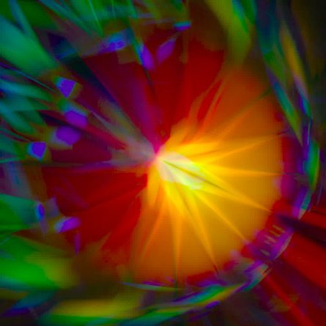
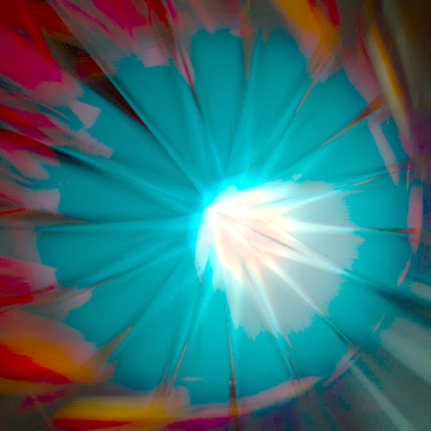
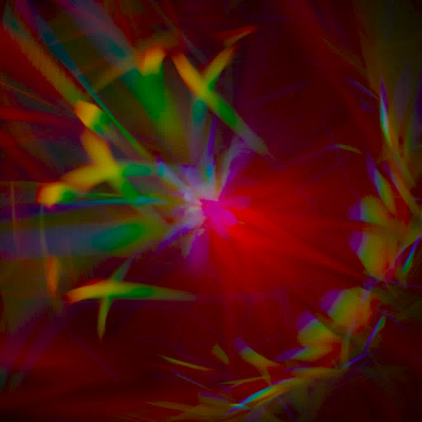
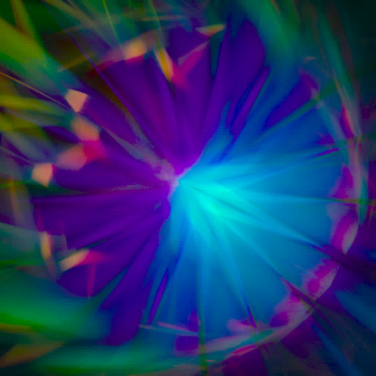
Spectral Ray Differentials
EGSR 2014, June 25-27, Lyon/France
Oskar Elek ^{(1,2,3)} Tobias Ritschel ^{(1,2,3)} Pablo Bauszat ⁽⁴⁾
Marcus Magnor ⁽⁴⁾ Hans-Peter Seidel ^{(1,2,3)}
Technische
Universität
Braunschweig

Slide 2
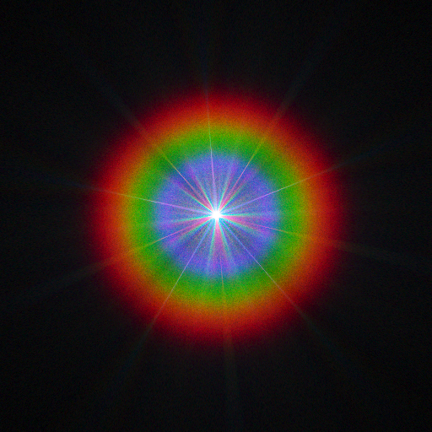
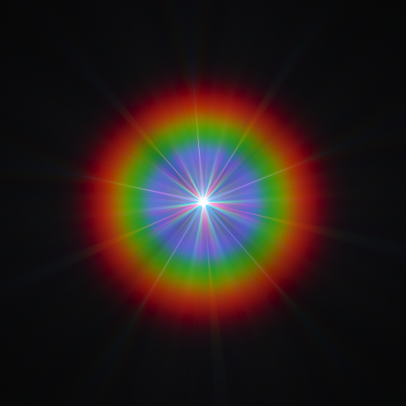
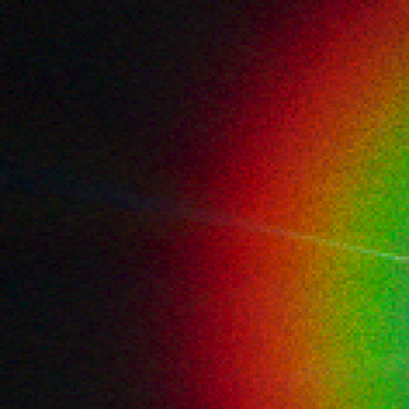
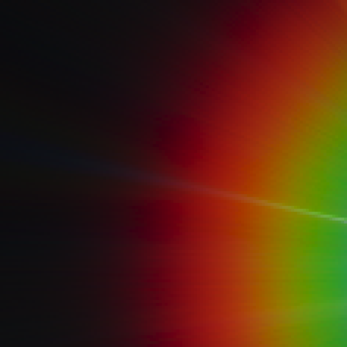
Oskar Elek: Spectral Ray Differentials
Teaser
Notes:
Something and something.

Slide 3
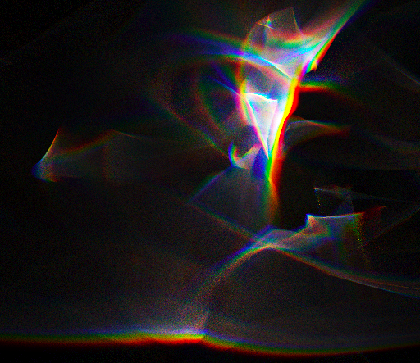
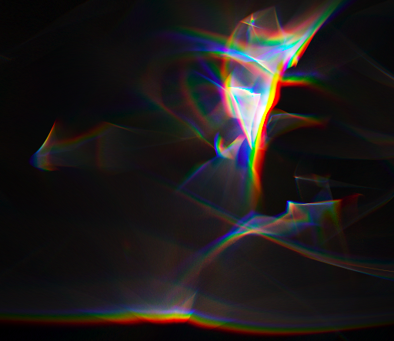
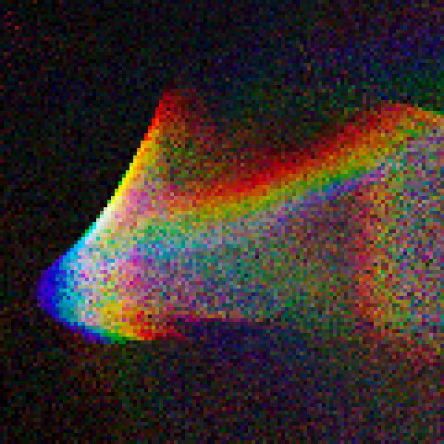
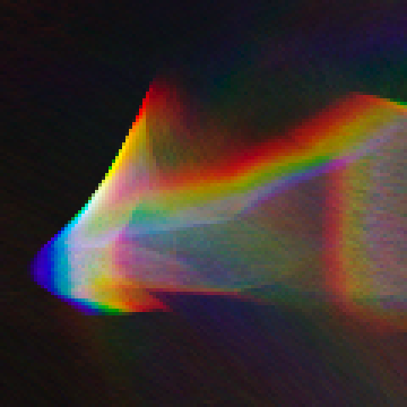
Oskar Elek: Spectral Ray Differentials
Teaser
Notes:
Simple and “free”.

Slide 4
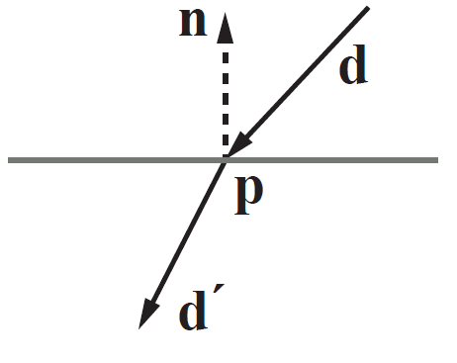
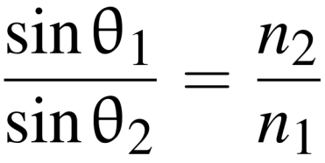
Oskar Elek: Spectral Ray Differentials
Dispersive refraction
Snell’s law:

Slide 5
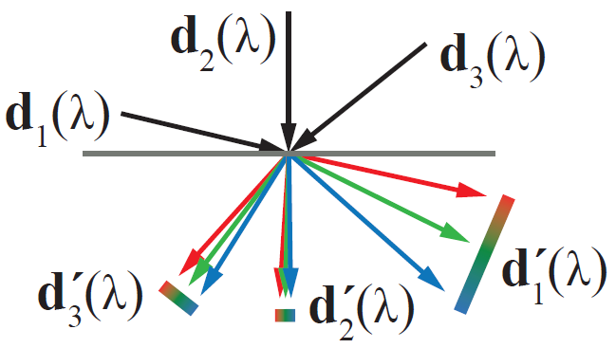
Oskar Elek: Spectral Ray Differentials
Dispersive refraction
Snell’s law:

Slide 6
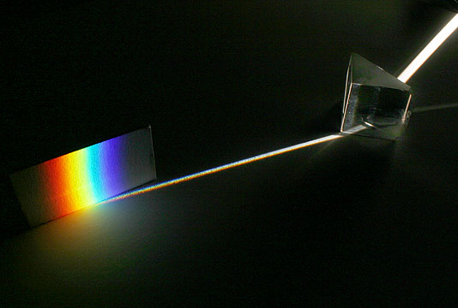
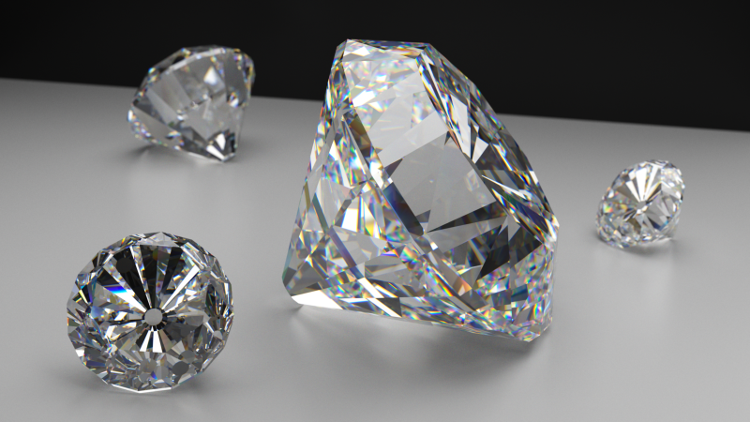
Oskar Elek: Spectral Ray Differentials
Dispersive refraction
Credit: Andrew Davidhazy
Credit: Peter Kutz

Slide 7
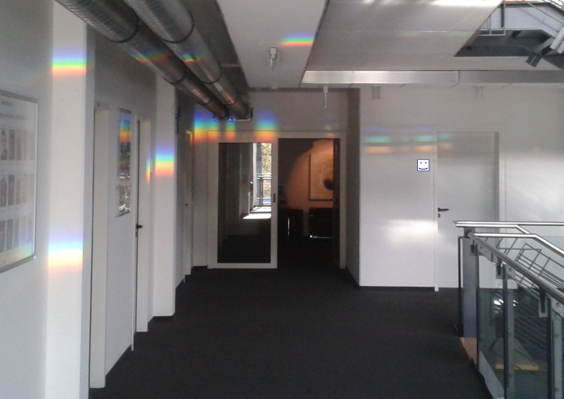
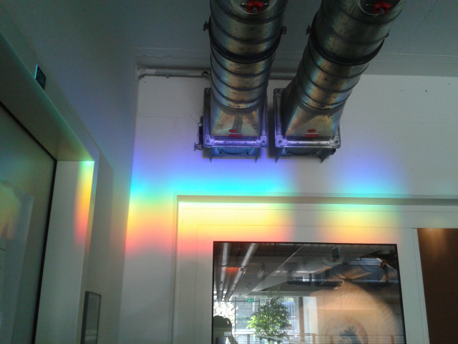
Oskar Elek: Spectral Ray Differentials
Dispersive refraction
Credit: Bad Mobile Phone Camera TM
Notes:
Angular phenomenon.

Slide 8
Oskar Elek: Spectral Ray Differentials
Dispersion rendering 101
Regular sampling

Slide 9
Oskar Elek: Spectral Ray Differentials
Dispersion rendering 101
Regular sampling
Stochastic sampling

Slide 10
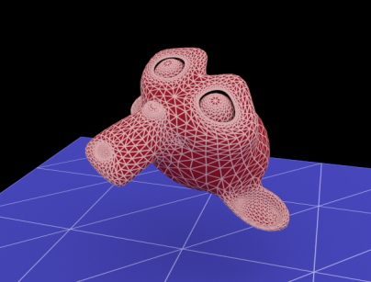
Oskar Elek: Spectral Ray Differentials
Dispersion rendering 101
Regular sampling
Stochastic sampling

Slide 11
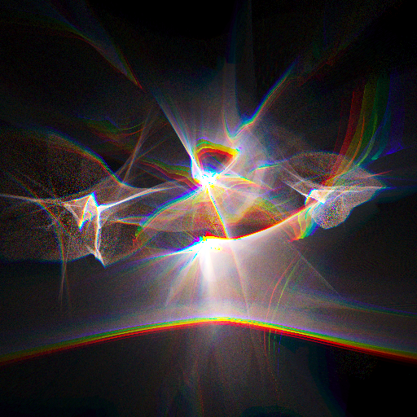
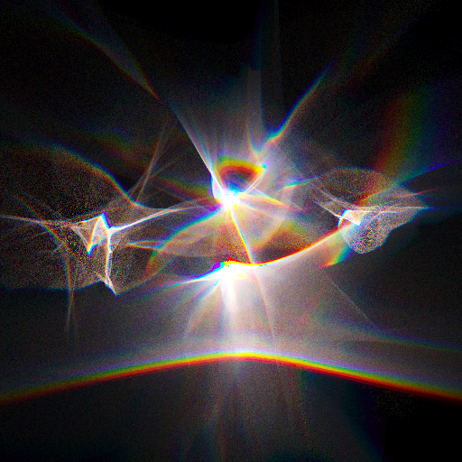
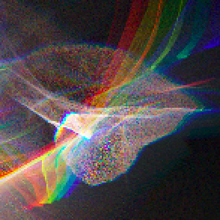
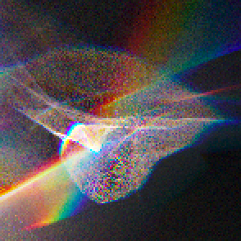
Oskar Elek: Spectral Ray Differentials
Dispersion rendering 101
Regular sampling
Stochastic sampling
Notes:
What improve independently on the sampling strategy (as long as it’s unbiased).

Slide 12
Oskar Elek: Spectral Ray Differentials
Dispersion rendering 101
Additional concerns
Requires spectral rendering
Tracing monochromatic rays

Slide 13
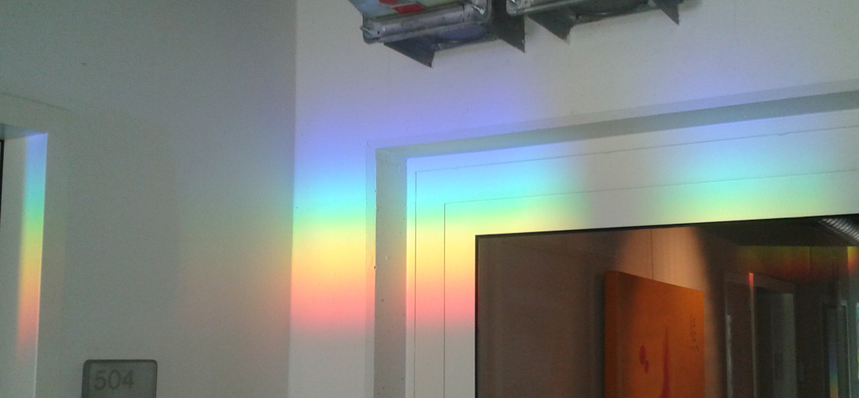
Oskar Elek: Spectral Ray Differentials
Dispersion rendering 101
Additional concerns
Requires spectral rendering
Tracing monochromatic rays
Reconstruction

Slide 14
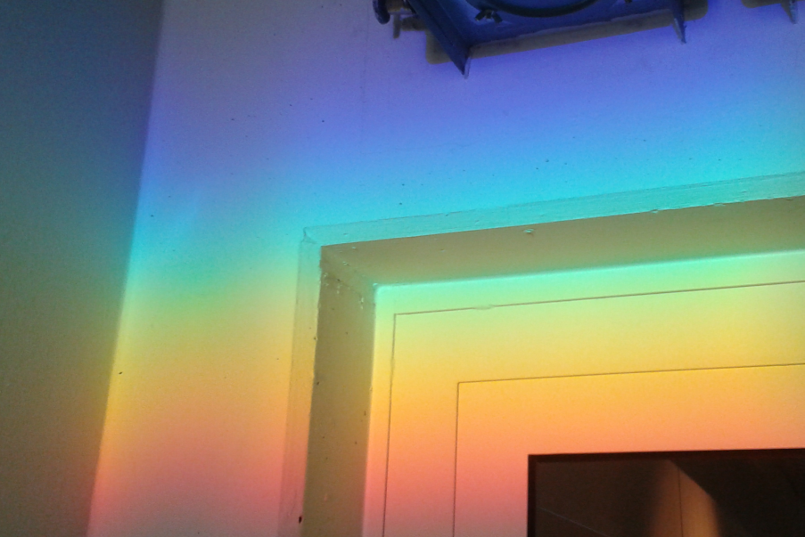
Oskar Elek: Spectral Ray Differentials
Dispersion rendering 101
Additional concerns
Requires spectral rendering
Tracing monochromatic rays
Reconstruction

Slide 15
Oskar Elek: Spectral Ray Differentials
Dispersion rendering 101
Additional concerns
Requires spectral rendering
Tracing monochromatic rays
Reconstruction
Notes:
Mention Alex’s paper.

Slide 16
Oskar Elek: Spectral Ray Differentials
Ray Differentials
Introduced by Igehy in 1999
Later extended to:
Paths (Suykens, Willems; 2001)
Photons (Schjoth, Frisvad, Erleben, Sporring; 2007)
Diffuse reflection (Fabianowski, Dingliana; 2009)

Slide 17
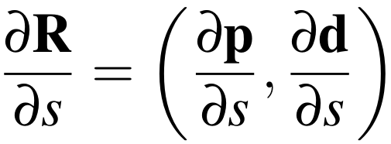
Oskar Elek: Spectral Ray Differentials
Ray Differentials
Introduced by Igehy in 1999
Later extended to:
Paths (Suykens, Willems; 2001)
Photons (Schjoth, Frisvad, Erleben, Sporring; 2007)
Diffuse reflection (Fabianowski, Dingliana; 2009)

Slide 18
Oskar Elek: Spectral Ray Differentials
Ray Differentials
Introduced by Igehy in 1999
Later extended to:
Paths (Suykens, Willems; 2001)
Photons (Schjoth, Frisvad, Erleben, Sporring; 2007)
Diffuse reflection (Fabianowski, Dingliana; 2009)

Slide 19
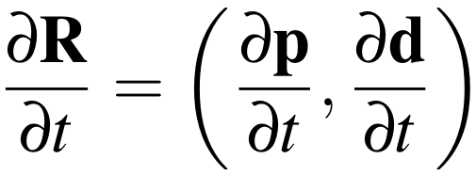
Oskar Elek: Spectral Ray Differentials
Ray Differentials
Introduced by Igehy in 1999
Later extended to:
Paths (Suykens, Willems; 2001)
Photons (Schjoth, Frisvad, Erleben, Sporring; 2007)
Diffuse reflection (Fabianowski, Dingliana; 2009)

Slide 20
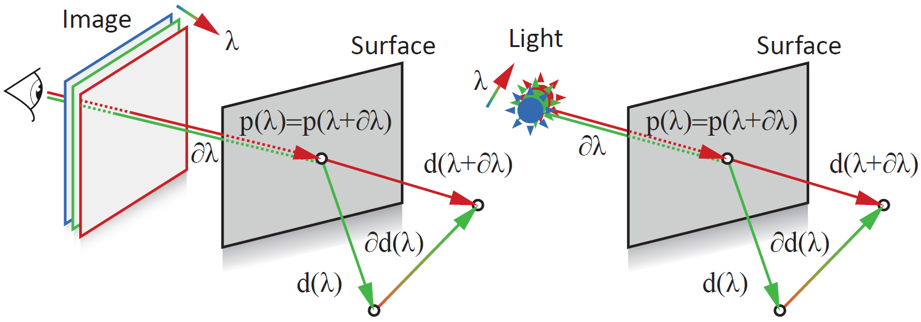
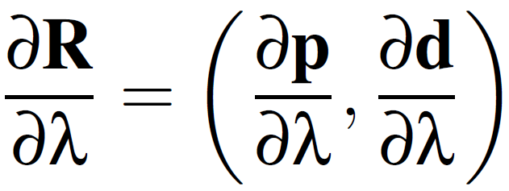
Oskar Elek: Spectral Ray Differentials
Spectral Ray Differentials

Slide 21
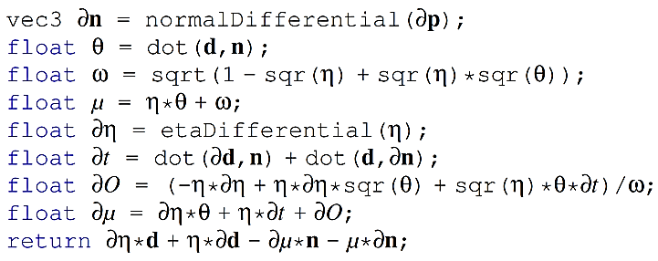
Oskar Elek: Spectral Ray Differentials
Spectral Ray Differentials

Slide 22
Oskar Elek: Spectral Ray Differentials
Spectral Ray Differentials

Slide 23
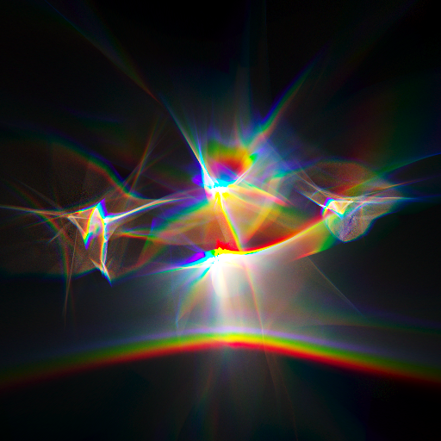
Oskar Elek: Spectral Ray Differentials
Spectral Ray Differentials
Download “Caustic – Spectral Decomposition” from tinyurl.com/SpectralRayDifferentials if video is missing

Slide 24
Oskar Elek: Spectral Ray Differentials
Application
Tracing
Identical to ray differentials

Slide 25
Oskar Elek: Spectral Ray Differentials
Application
Tracing
Identical to ray differentials
Reconstruction
1st order approximation

Slide 26
Oskar Elek: Spectral Ray Differentials
Application
Tracing
Identical to ray differentials
Reconstruction
1st order approximation

Slide 27
Oskar Elek: Spectral Ray Differentials
Application
Tracing
Identical to ray differentials
Reconstruction
1st order approximation

Slide 28
Oskar Elek: Spectral Ray Differentials
Application
Tracing
Identical to ray differentials
Reconstruction
1st order approximation

Slide 29
Oskar Elek: Spectral Ray Differentials
Application
Tracing
Identical to ray differentials
Reconstruction
1st order approximation
Regular
sampling
Stochastic
sampling

Slide 30
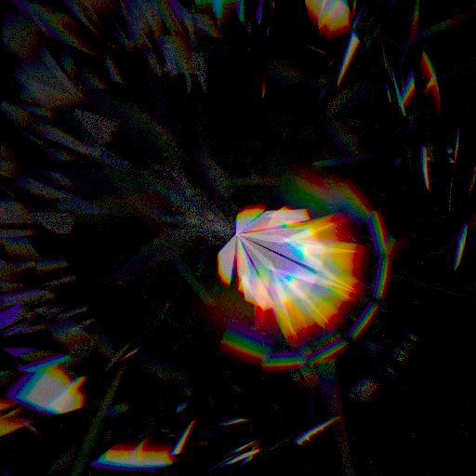
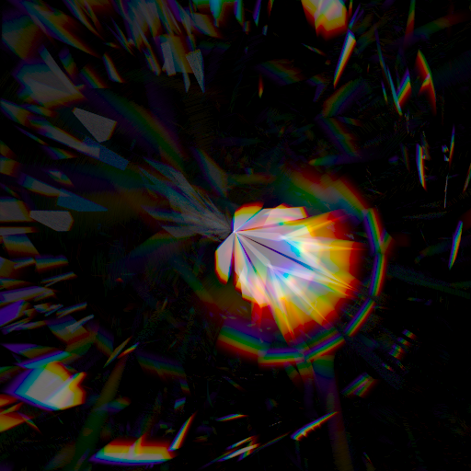
Oskar Elek: Spectral Ray Differentials
Results
Light Tracing (Arvo; 1986)
Stochastic - 2 minutes
Ours - 2 minutes
Stochastic - 60 minutes

Slide 31
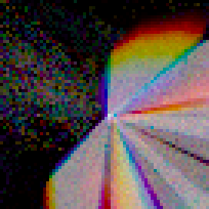
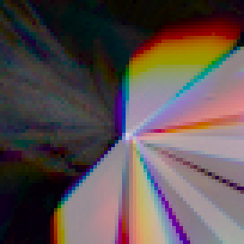
Oskar Elek: Spectral Ray Differentials
Results
Light Tracing (Arvo; 1986)
Stochastic - 2 minutes
Ours - 2 minutes
Stochastic - 60 minutes

Slide 32
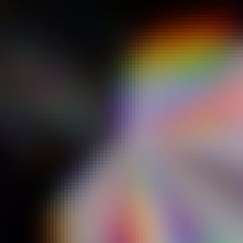
Oskar Elek: Spectral Ray Differentials
Results
Light Tracing (Arvo; 1986)
Stochastic - 2 minutes
Ours - 2 minutes
Stochastic - 60 minutes

Slide 33
Oskar Elek: Spectral Ray Differentials
Results
Light Tracing (Arvo; 1986)
Download “Caustic – Naive Sampling” from tinyurl.com/SpectralRayDifferentials if video is missing
Download “Caustic – Spectral Differentials” from tinyurl.com/SpectralRayDifferentials if video is missing
Stochastic - 1 minute / frame
Ours - 1 minute / frame
Notes:
Numerical quantification.

Slide 34
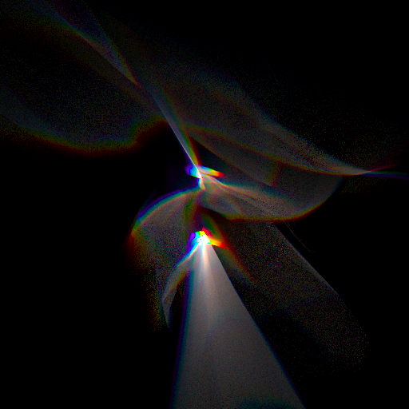
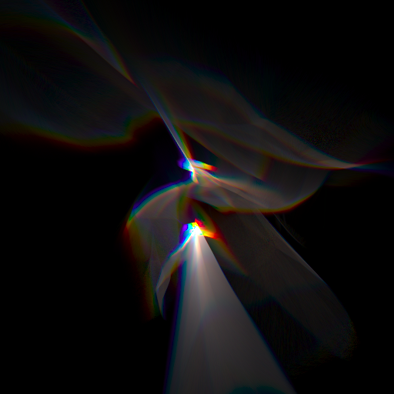
Oskar Elek: Spectral Ray Differentials
Results
Light Tracing (Arvo; 1986)
Stochastic - 1 minute / frame
Ours - 1 minute / frame

Slide 35
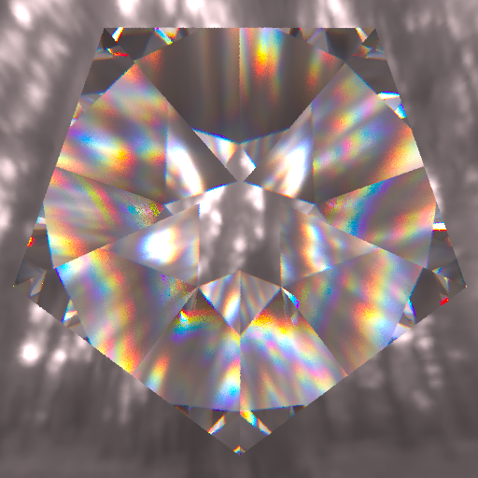
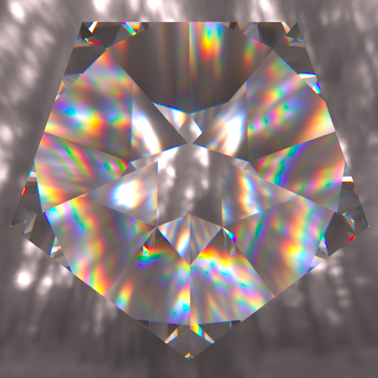
Oskar Elek: Spectral Ray Differentials
Results
Eye Tracing (Thomas; 1986)
Stochastic – 1 second
Ours - 1 second
Stochastic - 20 seconds

Slide 36
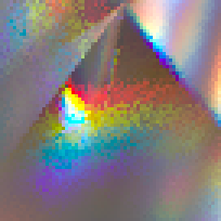
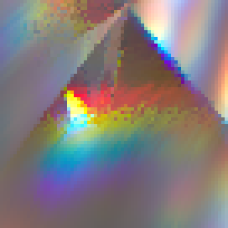
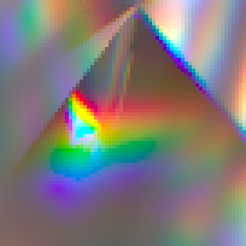
Oskar Elek: Spectral Ray Differentials
Results
Eye Tracing (Thomas; 1986)
Stochastic – 1 second
Ours - 1 second
Stochastic - 20 seconds

Slide 37
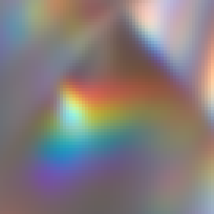
Oskar Elek: Spectral Ray Differentials
Results
Eye Tracing (Thomas; 1986)
Stochastic – 1 second
Ours - 1 second
Stochastic - 20 seconds
Notes:
Edges, bilateral filtering.

Slide 38
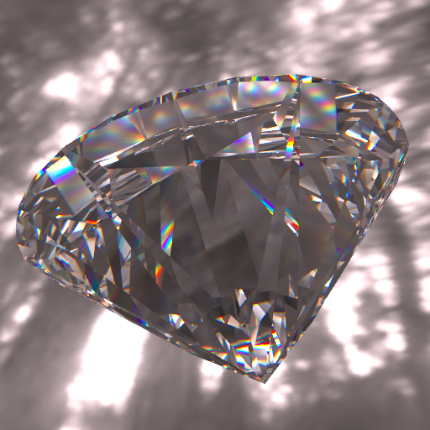
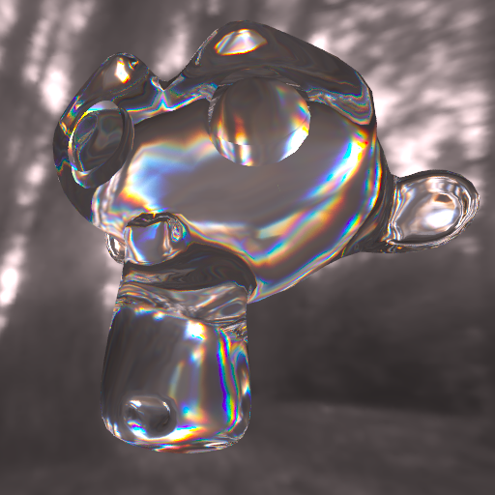
Oskar Elek: Spectral Ray Differentials
Results
Eye Tracing (Thomas; 1986)

Slide 39
Oskar Elek: Spectral Ray Differentials
Results
Real-time photon mapping (Wyman, Davis; 2006)
Photon splatting – 25 Hz

Slide 40
Oskar Elek: Spectral Ray Differentials
Results
Interactive on-screen caustic editing

Slide 41
Oskar Elek: Spectral Ray Differentials
Conclusion
Spectral Ray Differentials
Extend the happy family of ray differentials
Reconstruction / variance reduction method
Notes:
Almost for free.

Slide 42
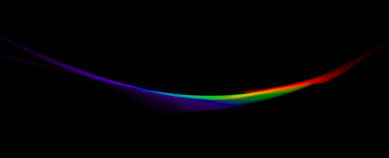
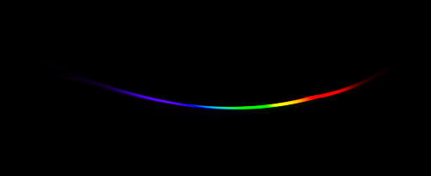
Oskar Elek: Spectral Ray Differentials
Conclusion
Spectral Ray Differentials
Extend the happy family of ray differentials
Reconstruction / variance reduction method
In future
Making SRD progressive
Notes:
Bias tradeoff.

Slide 43
Oskar Elek: Spectral Ray Differentials
Conclusion
Spectral Ray Differentials
Extend the happy family of ray differentials
Reconstruction / variance reduction method
In future
Making SRD progressive
Application to other phenomena
Notes:
Diffraction. Tomas’s talk.

Slide 44
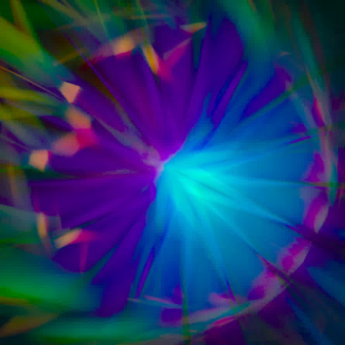
Spectral Ray Differentials
Oskar Elek ^{(1,2,3)} Tobias Ritschel ^{(1,2,3)} Pablo Bauszat ⁽⁴⁾
Marcus Magnor ⁽⁴⁾ Hans-Peter Seidel ^{(1,3)}
Technische
Universität
Braunschweig
Thanks
Antti Oulasvirta, Oliver Klehm, Alexander Wilkie, Karol Myszkowski
Anonymous reviewers
You!
More info
tinyurl.com/SpectralRayDifferentials

