Slide 1


Principled Kernel Prediction for Spatially Varying BSSRDFs
Oskar Elek and Jaroslav Křivánek
Charles University, Prague
This project has received funding from the European Union’s Horizon 2020 research and innovation programme under the Marie Sklodowska-Curie grant agreement No 642841.

Slide 2

Topic
Prediction of spatially varying BSSRDF
kernels from optical parameters
Scattering albedo
texture (here 2.5D)
Local approaches
Parameter aggregation
Ours
Path tracing reference
Notes:
We got interested in this while working on color and texture reproduction in 3D printing
These are preliminary, proof-of-concept results
The main point of presenting this is to incite further discussion based on preliminary, proof-of-concept results

Slide 3
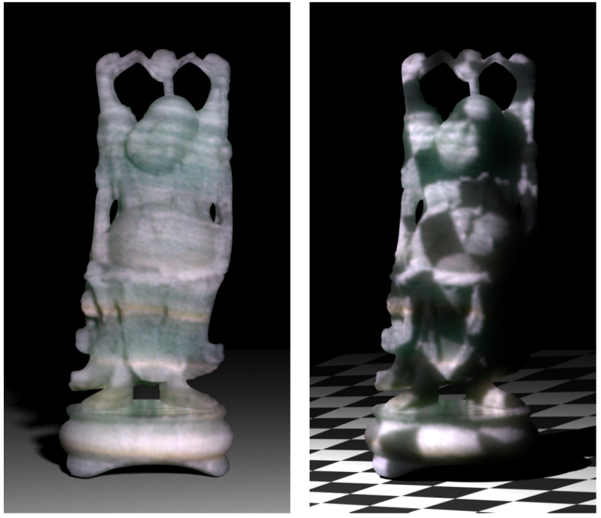
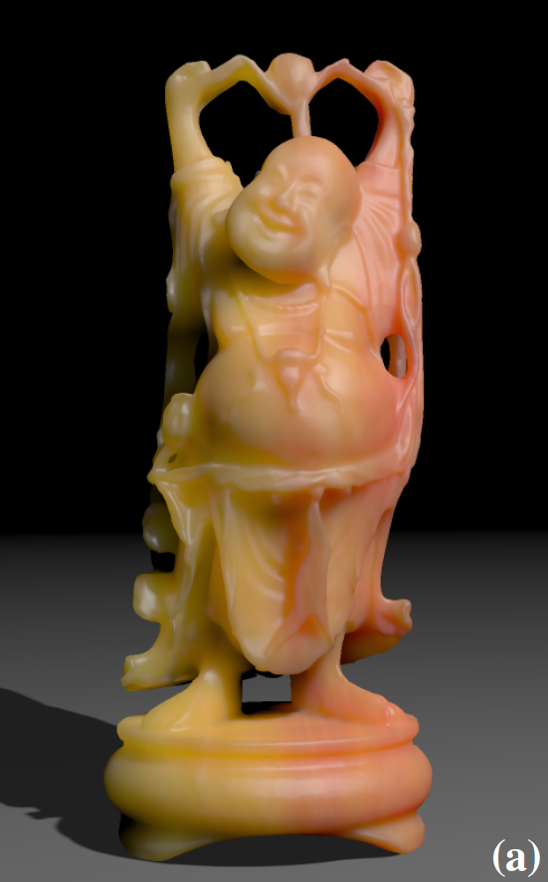
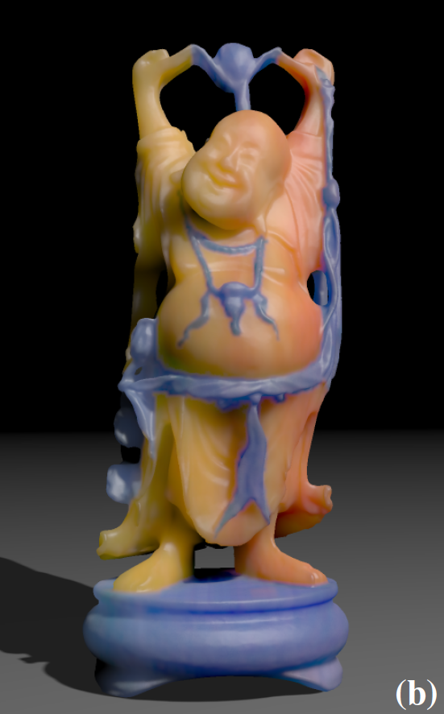
Topic
Not tackling SV-BSSRDF acquisition / compression / editing
[Peers et al. @ SIGGRAPH 2006]
[Song et al. @ SIGGRAPH 2009]
Notes:
This largely is a separate problem, the above papers are a good starting point
We actually compare to the factorized model proposed in these works though

Slide 4
BSSRDF and SV-BSSRDF
Uses and challenges

Slide 5
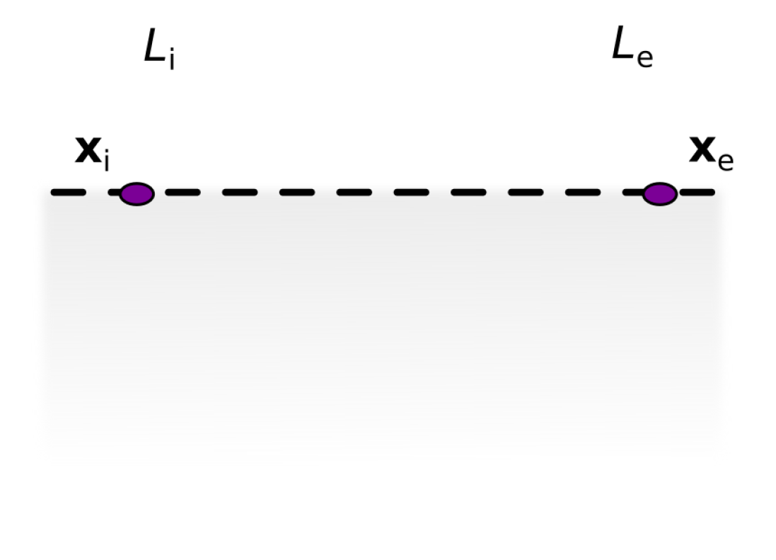
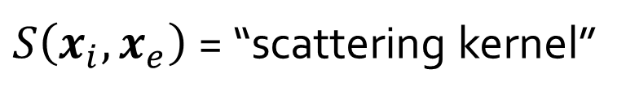
BSSRDF: Background
$S\left(x_{i},x_{e}\right)$= “scattering kernel”
Statistical estimate of point-to-point volumetric light transport
Notes:
Basic description what sub-surface scattering is and how to estimate it using a BSSRDF
The BSSRDF can be derived from first principles or empirically (e.g. by fitting to simulated/acquired data)
Roughly speaking, it’s a volumetric counterpart to a BRDF
Mention that for simplicity, we are going to operate on flat, half-infinite objects with properties defined by 2D textures (extruded vertically)

Slide 6
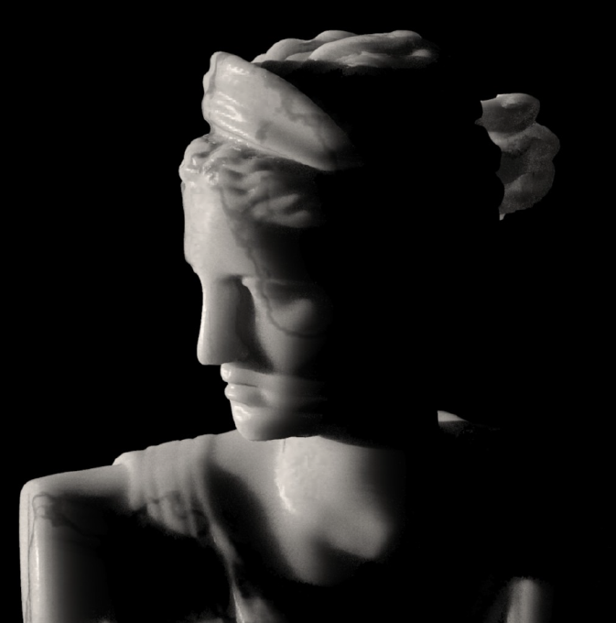
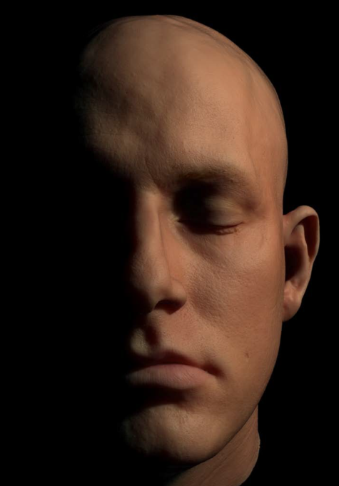
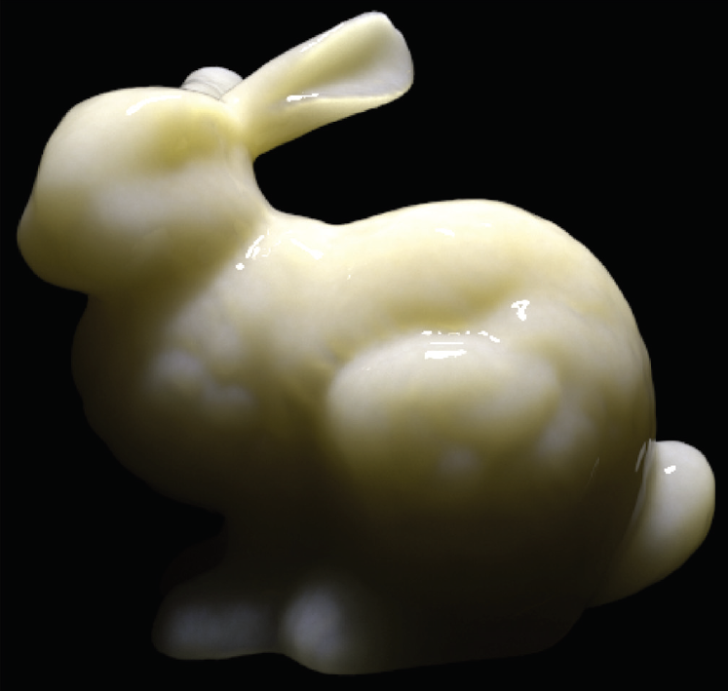
BSSRDF: Background
Great for (quasi-)homogeneous materials with well localized light transport…
[Jensen et al. @ SIGGRAPH 2001]
[Donner et al. @ SIGGRAPH 2005]
[Frisvad et al. @ ACM ToG 2014]
Notes:
Works well for homogeneous volumetric materials with transport on a small scale (smaller than some basic feature size)
Stone, skin, plastic, wax…

Slide 7
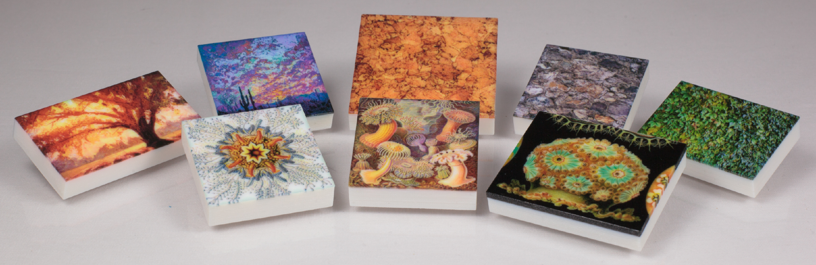
BSSRDF: Background
…but not so great when the transport scale exceeds the feature scale
[Elek, Sumin et al. @ SIGGRAPH Asia 2017]
Notes:
But less so when the geometric or optical features have higher frequency than the transport
This is what got us involved, since we’ve been interested in fabricating detailed color textures
The above (proportion between the scale of transport and material features) is the key consideration of our work

Slide 8
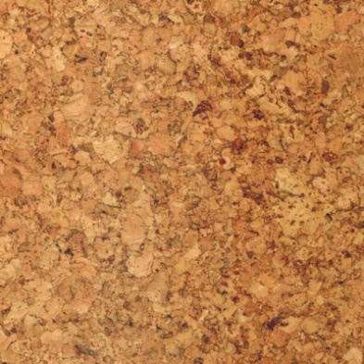

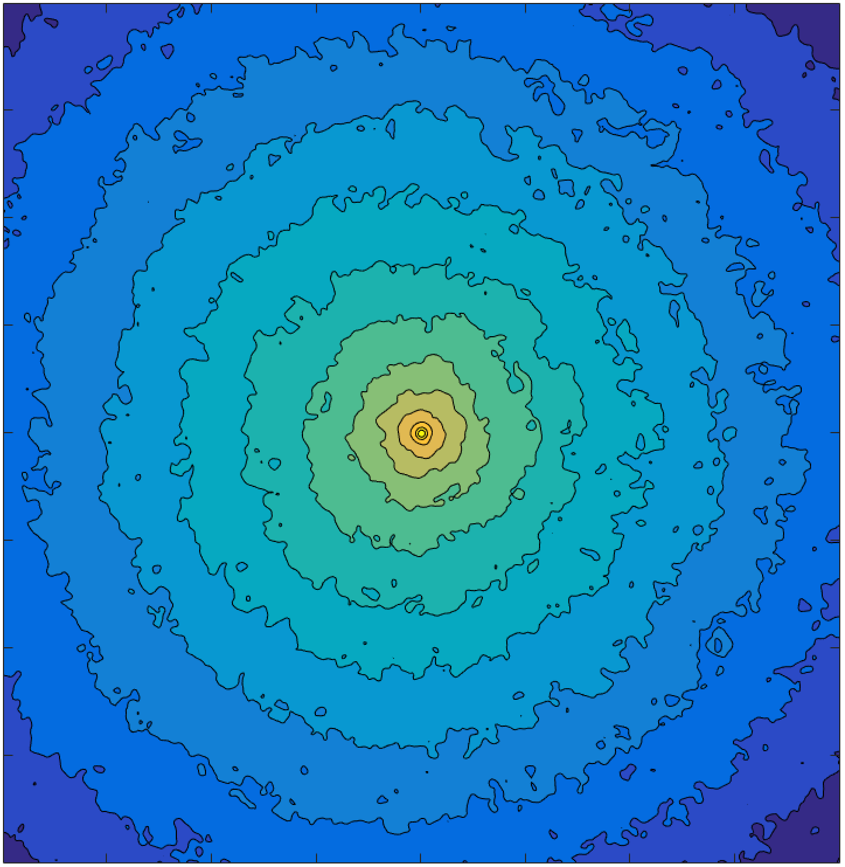
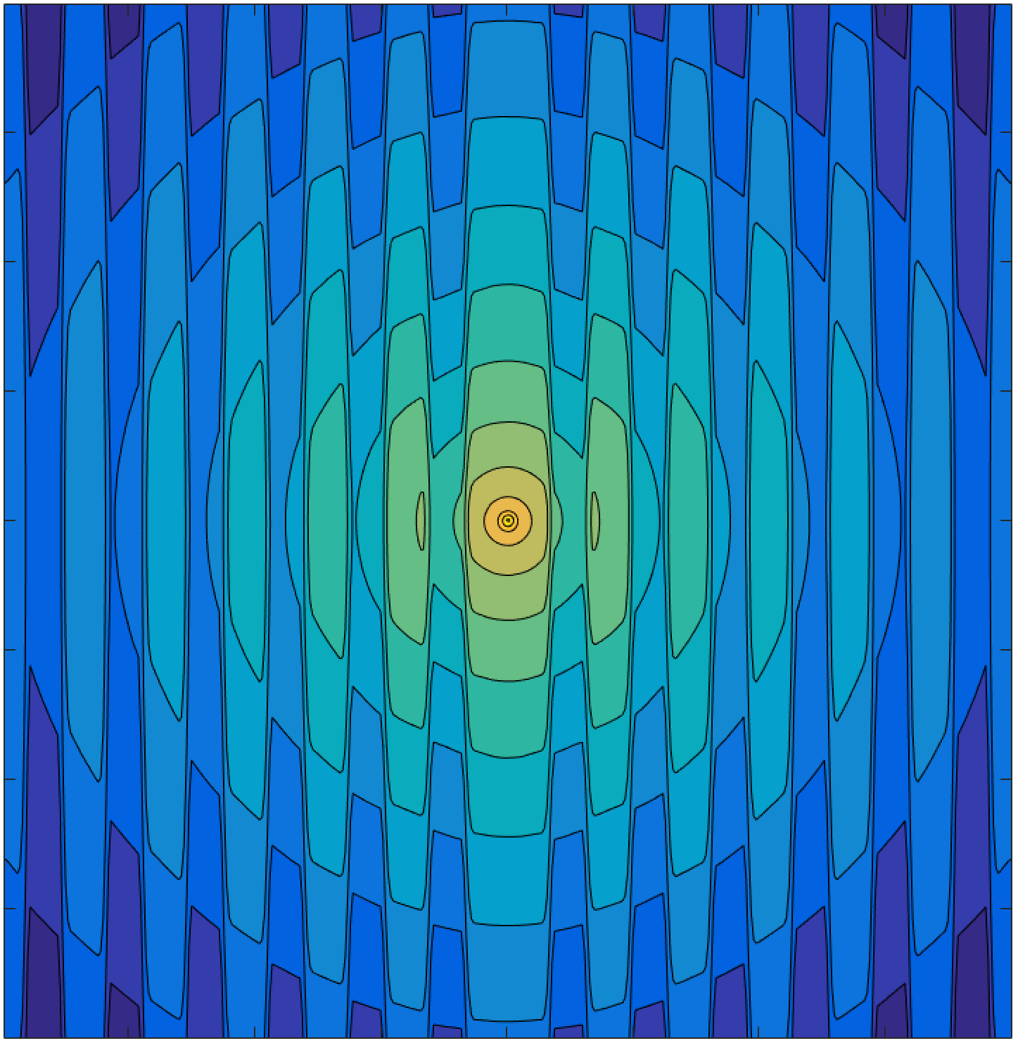
SV-BSSRDF: Kernel Shape
Albedo
Albedo
Point response (“kernel”)
Point response (“kernel”)
Notes:
For heterogeneous materials, however, the kernel is a rather messy function
It can be reasonably behaved for materials with regular or random structure…

Slide 9



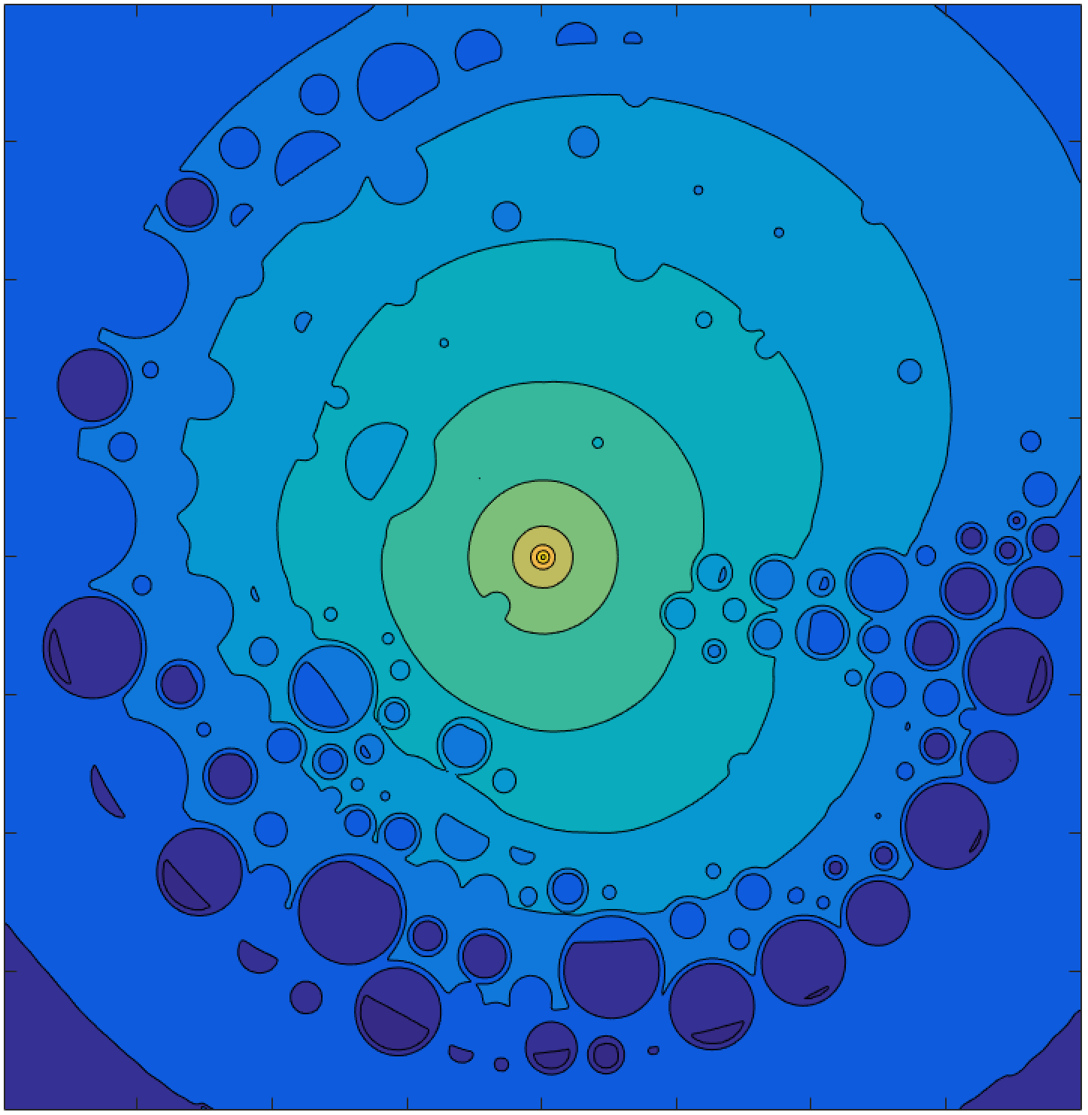
SV-BSSRDF: Kernel Shape
Albedo
Albedo
Point response (“kernel”)
Point response (“kernel”)
Notes:
…but for those with lots of explicit features, both the local and global structure determines the transport
And again: this problem becomes more apparent for transport ‘larger’ than the feature size

Slide 10
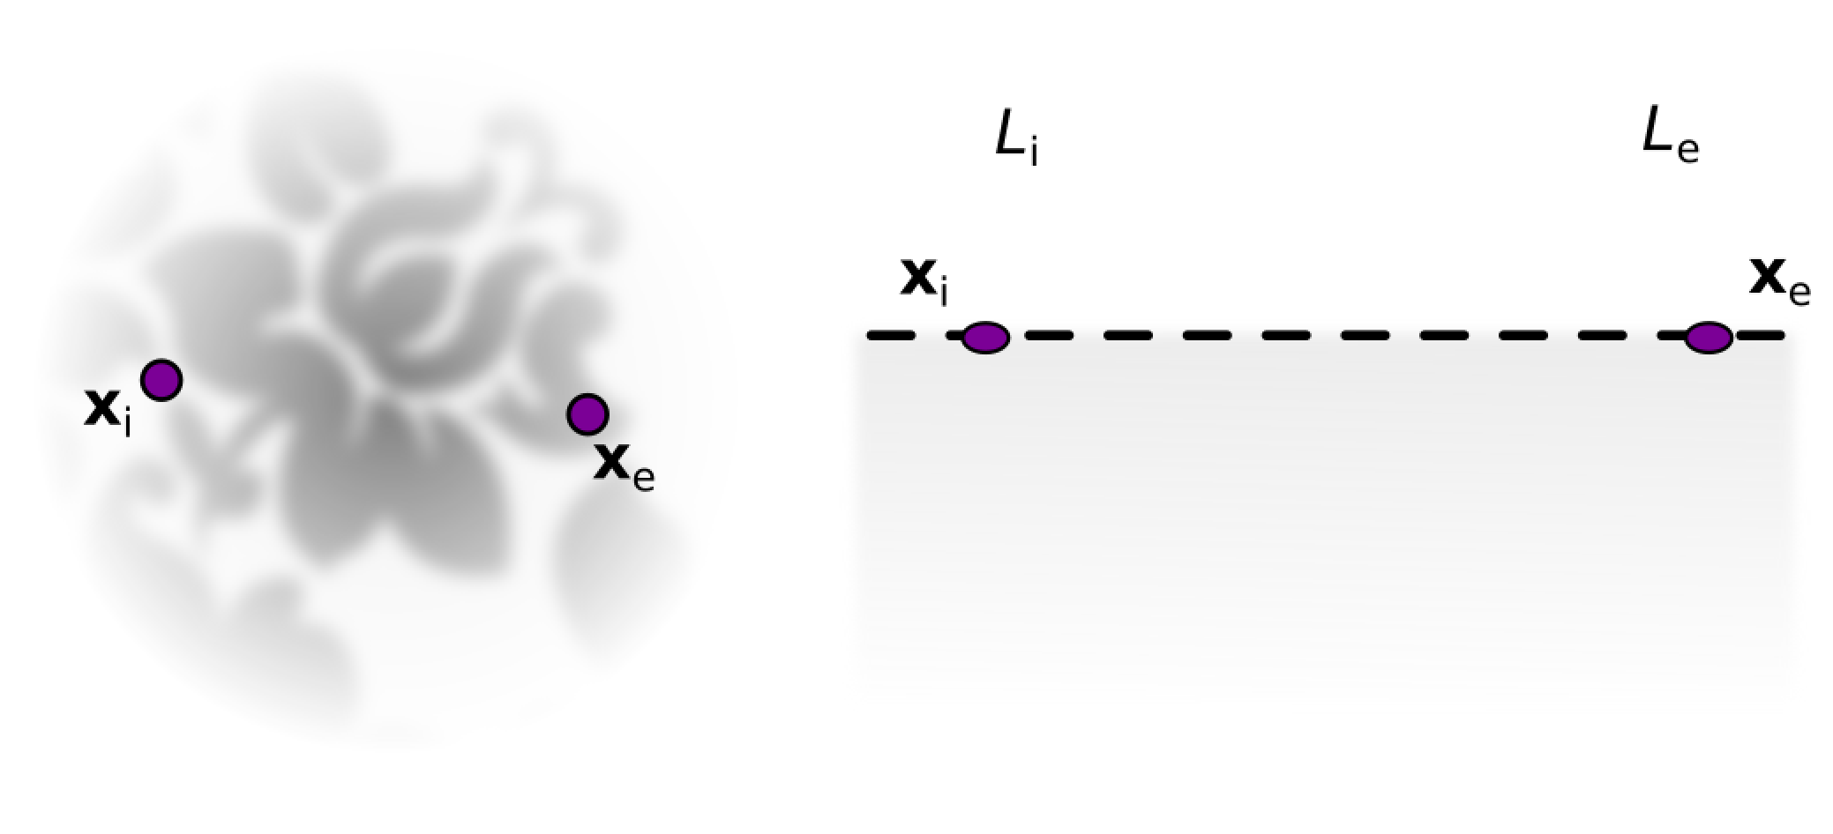



SV-BSSRDF: Kernel Shape
Albedo
Two key ideas:
Data-driven parameter aggregation
Decomposition of transport into local and global
$$f_{L}$$
$$f_{L}$$
$$f_{G}$$
Point response (“kernel”)
Notes:
The two key ideas that we employ here are:
1) statistically characterize the (unweighted) path distribution that connects Xi and Xe by an aggregation kernel
2) split the transport into local and global factors to account for both overall energy distribution and sensitivity to local features (essentially equivalent to single/multiple scattering decomposition)

Slide 11
Methodology
Step-by-step walkthrough

Slide 12
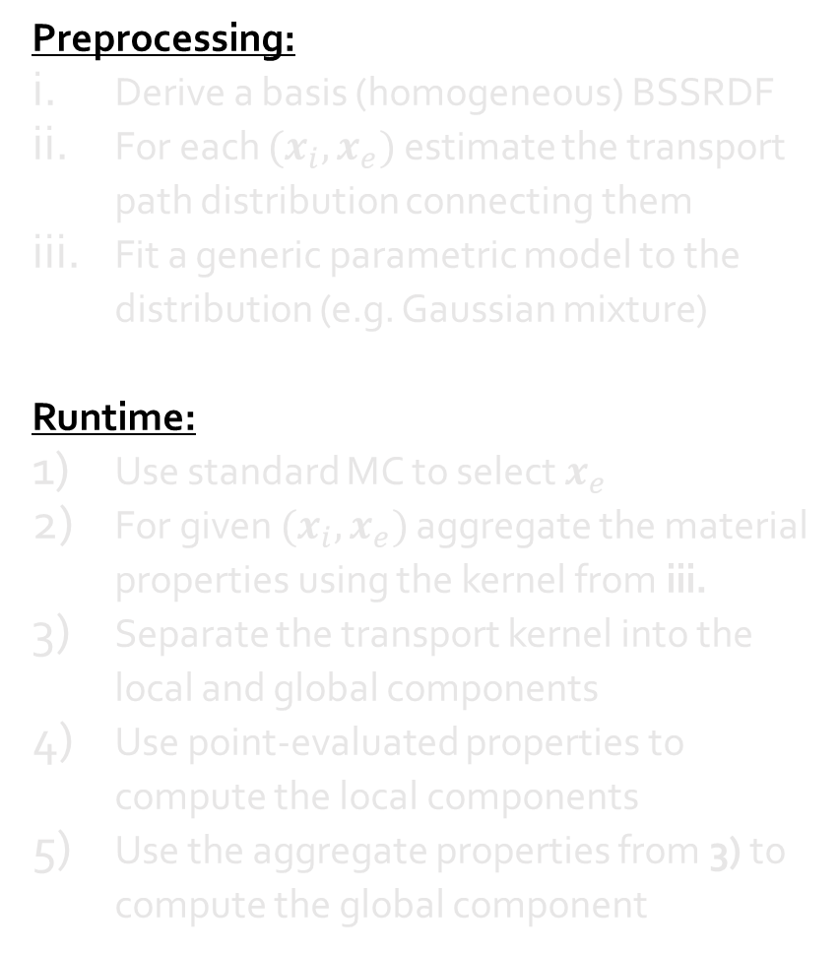
Method Outline
Preprocessing:
Derive a basis (homogeneous) BSSRDF
For each $(x_{i},x_{e})$ estimate the transport path distribution connecting them
Fit a generic parametric model to the distribution (e.g. Gaussian mixture)
Runtime:
Use standard MC to select $x_{e}$
For given $(x_{i},x_{e})$ aggregate the material properties using the kernel from iii.
Separate the transport kernel into the local and global components
Use point-evaluated properties to compute the local components
Use the aggregate properties from 3) to compute the global component
Notes:
What follows is a generic outline of the proposed methodology, a scheme if you will
Most of the steps are currently only proof-of-concept implementations; later we discuss how to generalize them in future
Preprocessing: understanding the light transport overall
Runtime: accounting for the specific parameter distribution in applying the model

Slide 13
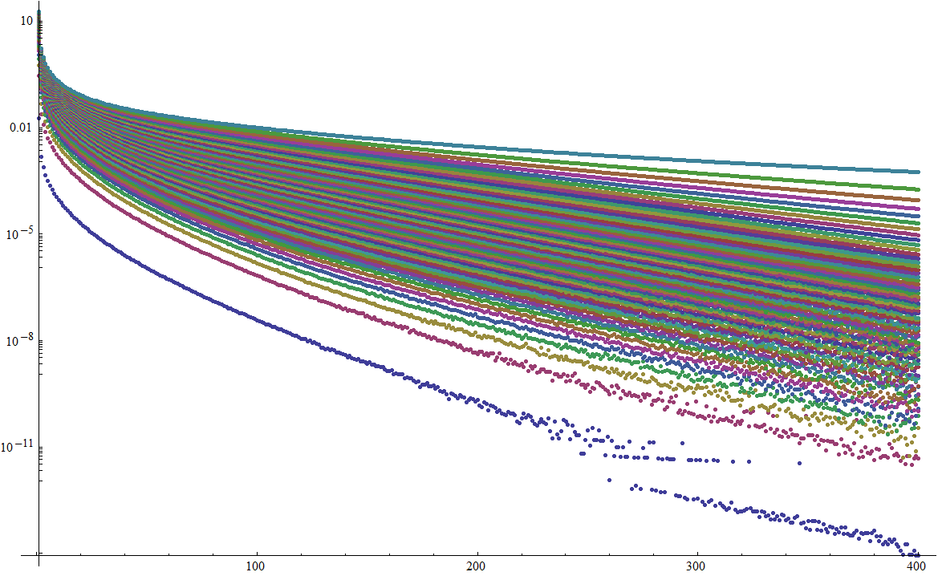
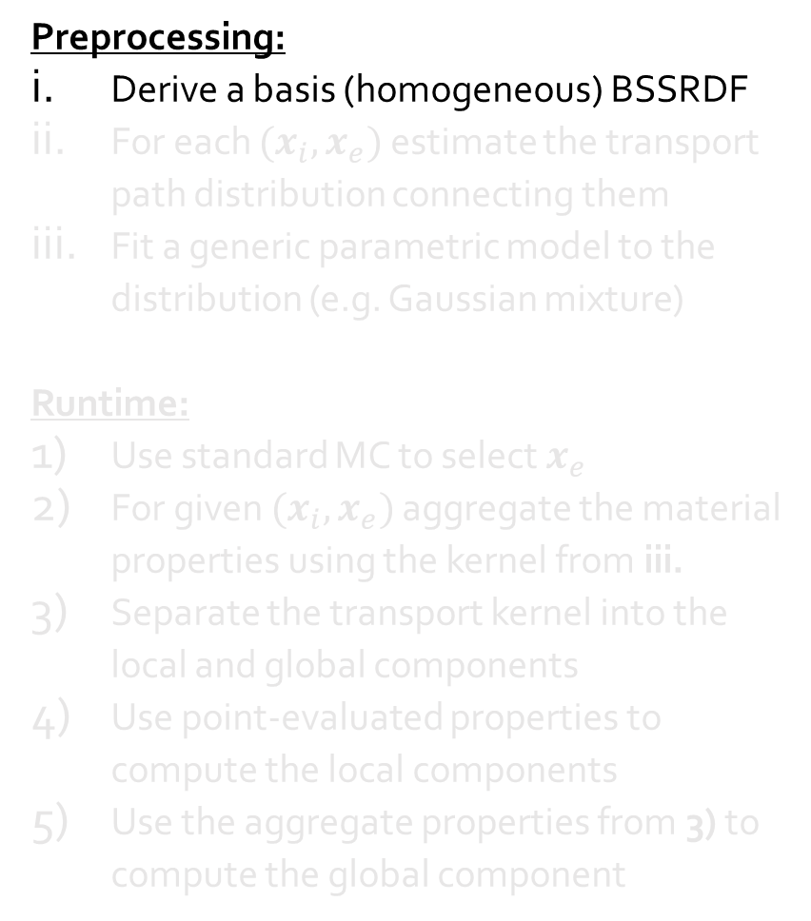
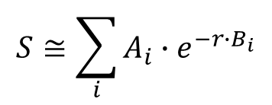
Method Outline
Preprocessing:
Derive a basis (homogeneous) BSSRDF
For each $(x_{i},x_{e})$ estimate the transport path distribution connecting them
Fit a generic parametric model to the distribution (e.g. Gaussian mixture)
Runtime:
Use standard MC to select $x_{e}$
For given $(x_{i},x_{e})$ aggregate the material properties using the kernel from iii.
Separate the transport kernel into the local and global components
Use point-evaluated properties to compute the local components
Use the aggregate properties from 3) to compute the global component
different albedos
0 MFP
10 MFP
normalized radial distance
BSSRDF kernel:
$$S≅\sum_{i}{A_{i}∙e^{{−r∙B}_{i}}}$$
Also see [Christensen and Burley @ SIGGRAPH Talks 2015]
Notes:
To obtain as accurate as possible homogeneous BSSRDF, we fit to a brute-force analog MC simulated data
Then fit a mixture of negative exponentials (i=1..6) parametrized by MFP-normalized radial distance and albedo (fixing IOR=1.5 and scattering isotropy g=0.3)
Similar to Christensen, who however assume index-matched materials

Slide 14

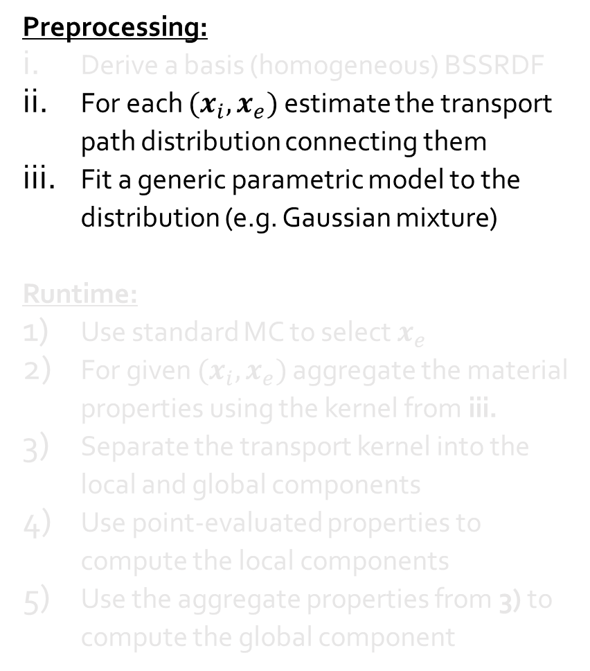
Method Outline
Preprocessing:
Derive a basis (homogeneous) BSSRDF
For each $(x_{i},x_{e})$ estimate the transport path distribution connecting them
Fit a generic parametric model to the distribution (e.g. Gaussian mixture)
Runtime:
Use standard MC to select $x_{e}$
For given $(x_{i},x_{e})$ aggregate the material properties using the kernel from iii.
Separate the transport kernel into the local and global components
Use point-evaluated properties to compute the local components
Use the aggregate properties from 3) to compute the global component
Distribution of unweighted sub-surface paths
Line: [d’Eon and Irving
@ SIGGRAPH 2011]
Ellipse: [Sone et al.
@ EG Shorts 2017]
Notes:
We want to explicitly account for the material distribution around Xi and Xe, but still do this in a principled way
Idea: statistically average unweighted (i.e. as if in a homogeneous medium) transport paths and describe the distribution (density) by a generic aggregation kernel
This doesn’t rely on any heuristics, as opposed to previous approaches

Slide 15
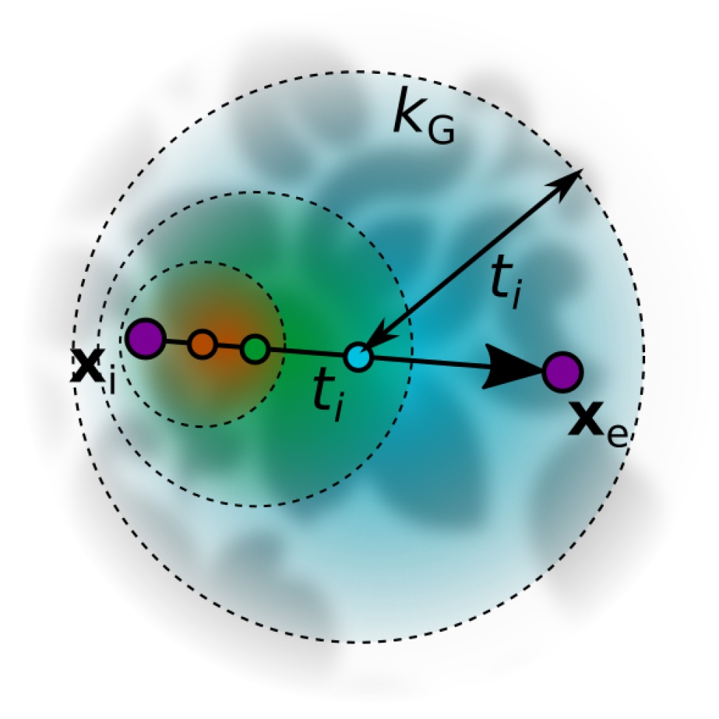
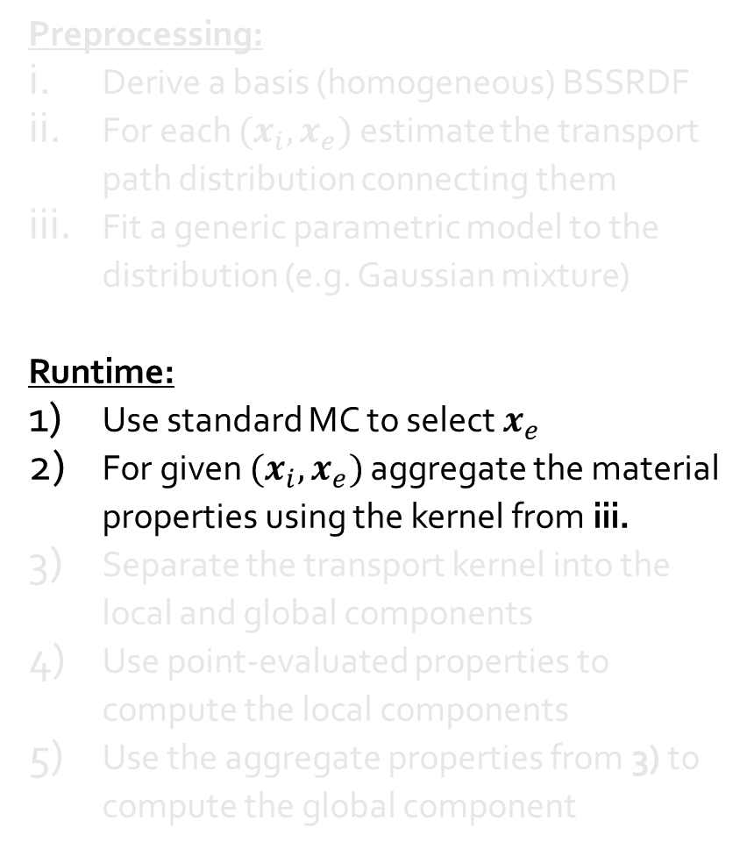
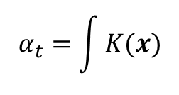
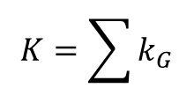
Method Outline
Preprocessing:
Derive a basis (homogeneous) BSSRDF
For each $(x_{i},x_{e})$ estimate the transport path distribution connecting them
Fit a generic parametric model to the distribution (e.g. Gaussian mixture)
Runtime:
Use standard MC to select $x_{e}$
For given $(x_{i},x_{e})$ aggregate the material properties using the kernel from iii.
Separate the transport kernel into the local and global components
Use point-evaluated properties to compute the local components
Use the aggregate properties from 3) to compute the global component
Aggregation kernel:
‘Transport’ albedo:
$$K=\sum{k_{G}}$$
$$α_{t}=\int{K(x)}$$
Notes:
Currently we use uniform sampling within the illuminated area (discussion about IS later)
The aggregation kernel is a 3-component GMM, evaluated in constant time using a Gaussian pyramid (as opposed to MC intagration of Sone2017)
This yields the ‘transport’ parameters (now just the albedo)

Slide 16
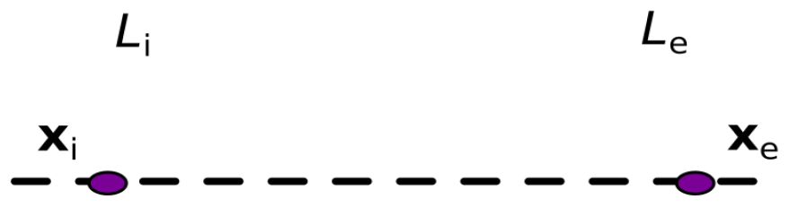






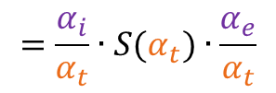

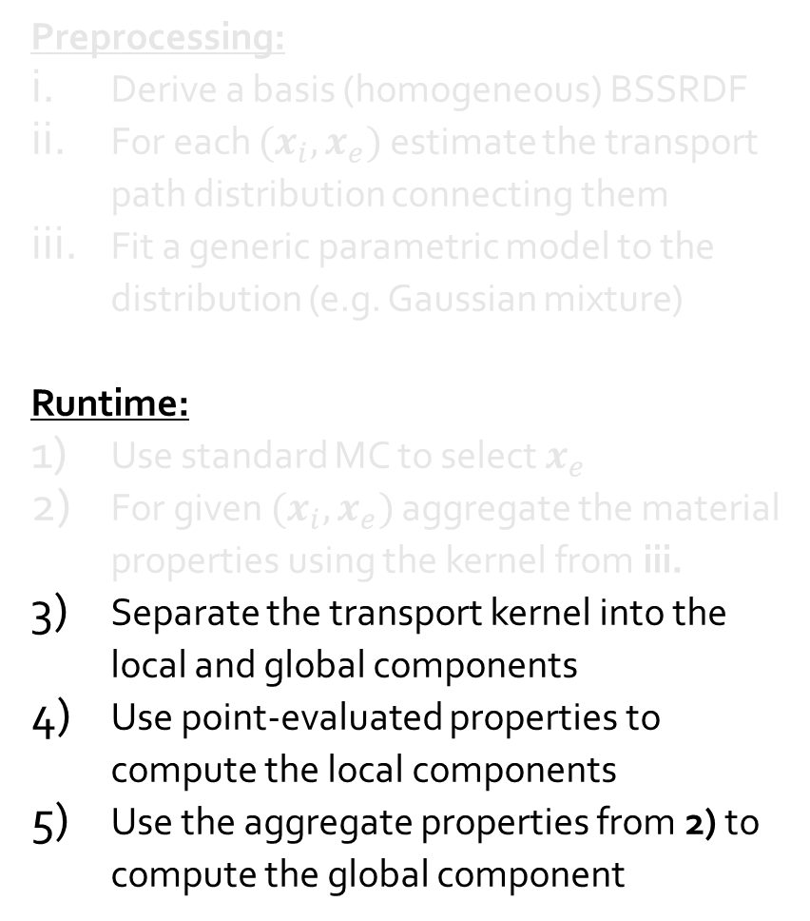
Method Outline
Preprocessing:
Derive a basis (homogeneous) BSSRDF
For each $(x_{i},x_{e})$ estimate the transport path distribution connecting them
Fit a generic parametric model to the distribution (e.g. Gaussian mixture)
Runtime:
Use standard MC to select $x_{e}$
For given $(x_{i},x_{e})$ aggregate the material properties using the kernel from iii.
Separate the transport kernel into the local and global components
Use point-evaluated properties to compute the local components
Use the aggregate properties from 2) to compute the global component
$$f_{L}$$
$$f_{L}$$
$$f_{G}$$
$S_{V}=f_{L}(x_{i})∙f_{G}(x_{i},x_{e})∙f_{L}(x_{e}$)
$$=\frac{α_{i}}{α_{t}}∙S(α_{t})∙\frac{α_{e}}{α_{t}}$$
Factorization:
Aggregation:
$$S_{V}=\sqrt{S(α_{i})∙S(α_{e})}$$
$$S_{V}=S(α_{t})$$
[Song et al. @ SIGGRAPH 2009]
[Sone et al. @ EG Shorts 2017]
Notes:
To rephrase, the idea is to account for both the local material properties at Xi/Xe, and the global distribution in their surroundings
Currently we simply read out the local albedos, but rigorously averaging the distribution of single-scattering sites would be better
Why is this advantageous? Both evaluated alternatives – factorization and aggregation – miss either the global or local features
This is not to talk down factorization! It’s just not meant for this in first place – we merely use it as a stand-in for other local heuristics…

Slide 17
Evaluation
Overall quality and detail preservation

Slide 18
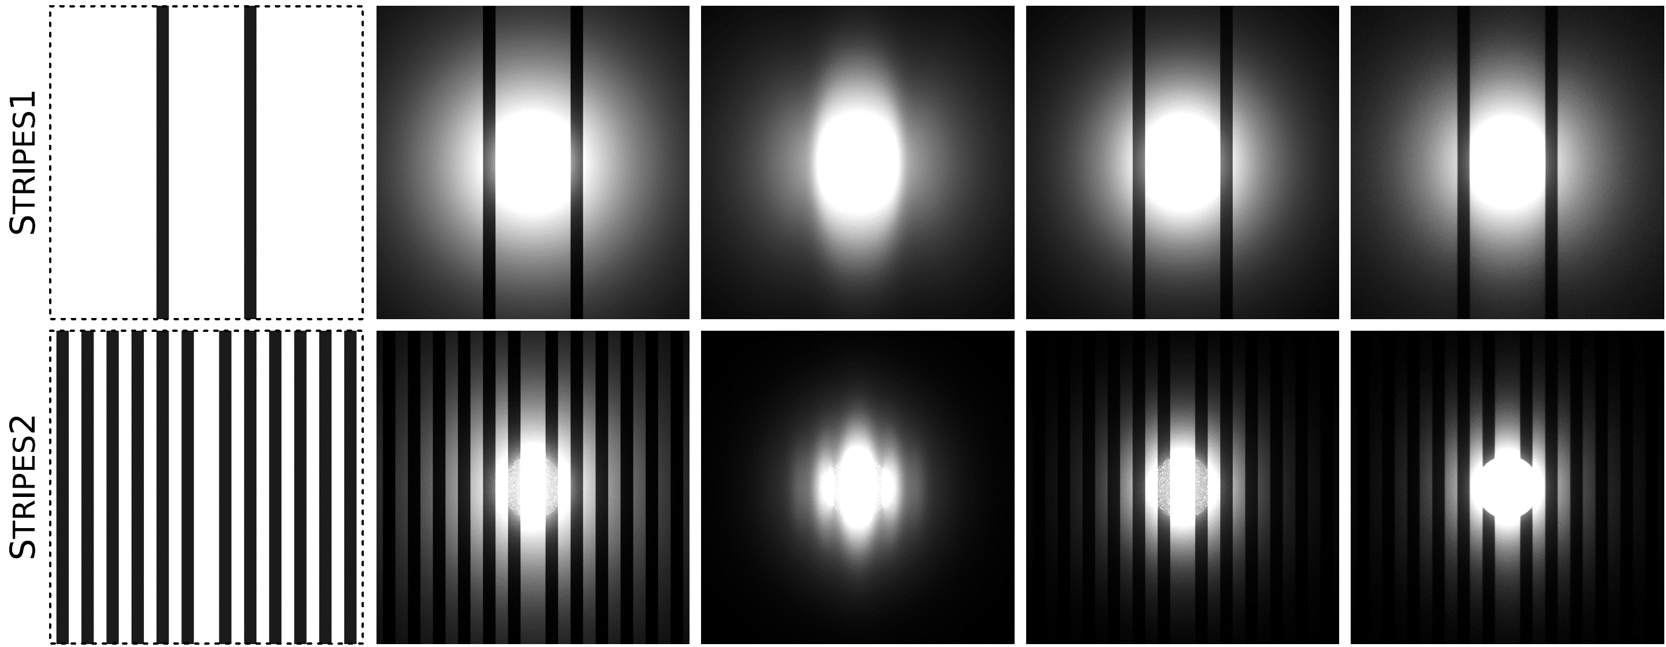
Evaluation: Simple Structures
Notes:
- Simple canonical scene: flat textured object, constant optical density, cone light with radius 1 MFP

Slide 19
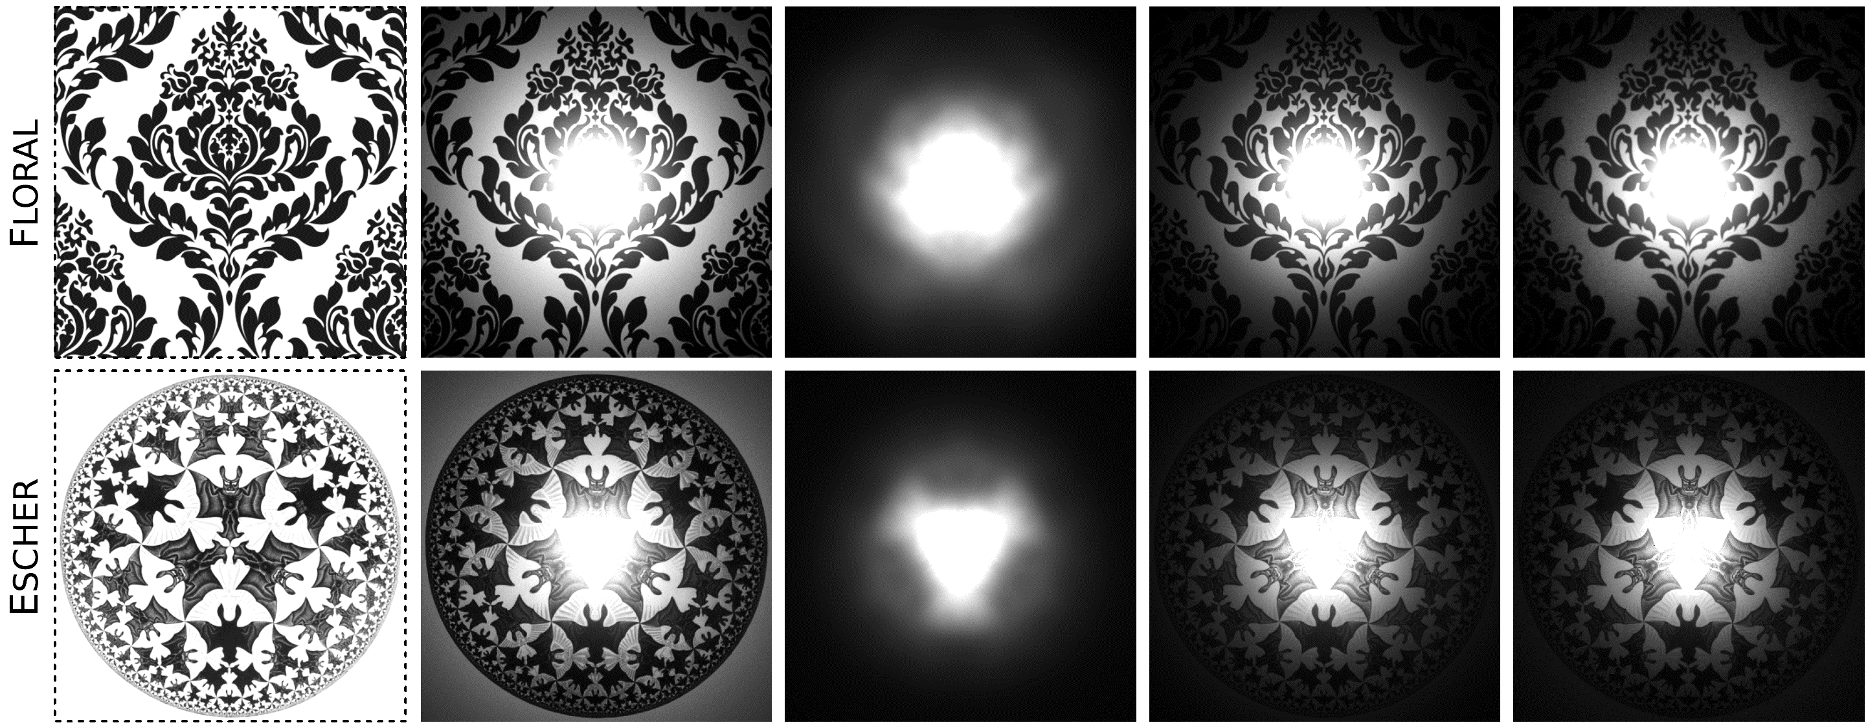
Evaluation: Complex Structures
Notes:
- Simple canonical scene: flat textured object, constant optical density, cone light with radius 1 MFP

Slide 20
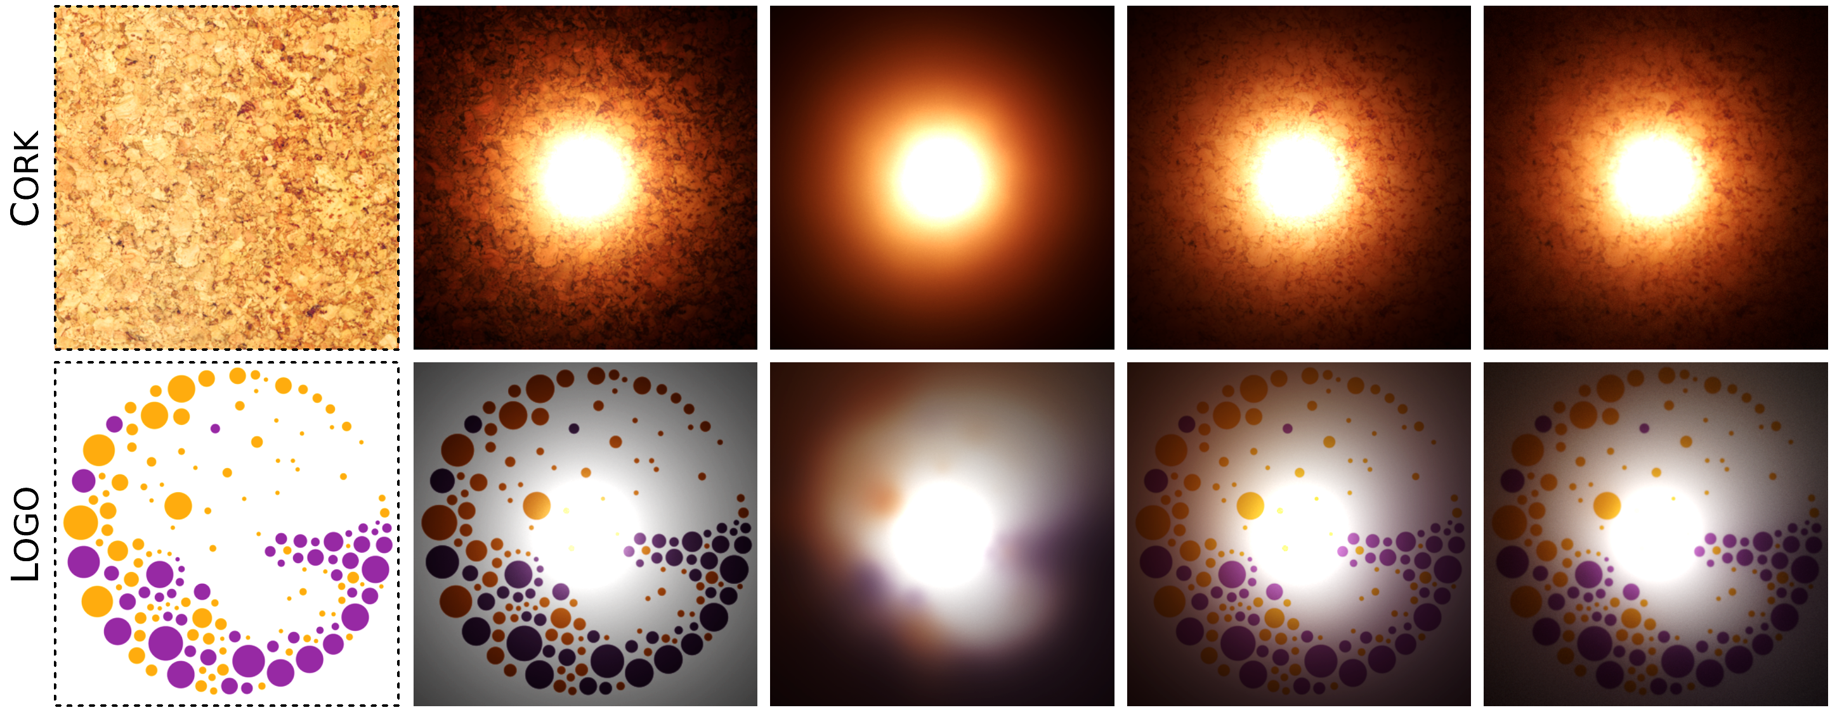
Evaluation: Color Features
Notes:
- Simple canonical scene: flat textured object, constant optical density, cone light with radius 1 MFP

Slide 21
Evaluation: Feature Preservation
Notes:
- Same scene as before, but the light radius is 4 MFP and we vary optical density

Slide 22
Discussion
What follows?

Slide 23
Future Work
Principled aggregation kernel
  Currently only a manual fit
Notes:
Paper: At the moment, the parameter aggregation kernel is fit manually, as a proof of concept. A better course of action would be numerically fitting a meta-parametric model to the distributions of (contribution-weighted) sub-surface paths for every pair of surface points and required medium parametrizations. Such a meta-model would then output the aggregation kernel on-the-fly, for instance again in the form of a Gaussian mixture model.

Slide 24
Future Work
Principled aggregation kernel
Spatial variation of all material parameters
  Currently only scattering albedo
[Hasan et al. @ SIGGRAPH 2010]
Notes:
Paper: While the aggregation of other medium properties beyond the scattering albedo is desirable, arguably the most relevant is handling the optical density. We conjecture that rather than using a simple average [SHK17], it should be used as a scaling factor during the albedo aggregation. This of course needs to be verified by future experiments.

Slide 25

Future Work
Principled aggregation kernel
Spatial variation of all material parameters
Importance sampling
  Currently only uniform sampling of incident illumination
$$f_{L}$$
$$f_{L}$$
$$f_{G}$$
$S_{V}=f_{L}(x_{i})∙f_{G}(x_{i},x_{e})∙f_{L}(x_{e}$)
Notes:
Paper: Our implementation currently uses a uniform distribution of sample points during the evaluation, resulting in significant noise even after 1k samples. The main challenge in deriving an efficient importance-sampling scheme for the proposed model is that rather than given explicitly, the SV-BSSRDF is implicitly defined by the pair of sampling points. One possible approach to tackle this circular dependence could be a multi-level sampling scheme, where the sample point were found iteratively, based on increasingly more accurate estimates of the transport kernel.

Slide 26
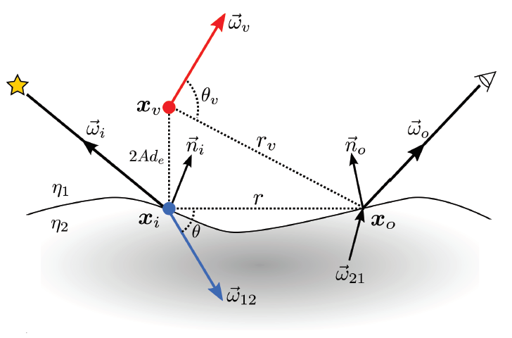
Future Work
Principled aggregation kernel
Spatial variation of all material parameters
Importance sampling
General 3D geometry and parameter distributions
  Current solution limited to 2.5D objects
[Frisvad et al. @ ACM ToG 2014]
Notes:
Paper: Since the basis BSSRDF determines the accuracy of the global transport, research in this direction is highly relevant. Also, to make the aggregation work for more general geometries and full 3D material parameters distributions, additional investigation of higher-dimensional aggregation kernels and surface-adaptive sampling techniques [FHK14,SHK17] is, too, warranted.

Slide 27
Principled Kernel Prediction for Spatially Varying BSSRDFs
Oskar Elek and Jaroslav Křivánek
Charles University, Prague
This project has received funding from the European Union’s Horizon 2020 research and innovation programme under the Marie Sklodowska-Curie grant agreement No 642841.

Slide 28
Extra Slides

Slide 29
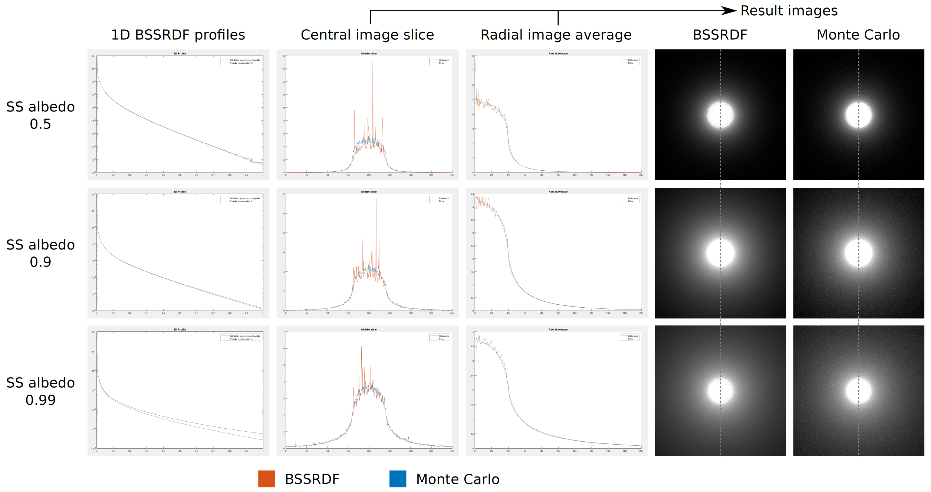
Basis BSSRDF

Slide 30
Full Results

